Slide 1
BB Scheduler Course Archive
Waukesha School District/Obsidian Solutions

Slide 2
Agenda
Review Course Archive Feature
Discuss Functionality
Discuss GUI Locations

Slide 3
Course Archive Functionality
Course Archive
BB Course is set to Unavailable
SDW Entries for BB Course are deleted
SDWBlackboardSchedulerBbCourses
SDWBlackboardSchedulerSISCoursePersons
SDWBlackboardSchedulerSISCourseSections
Mass Update Feature?
Based on TERM?
Notes:
p Delete

Slide 4
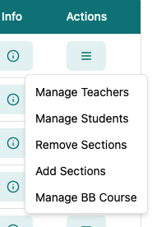
GUI Locations
Course Archive - GUI
BB Courses – New Action
Notes:
- DONE

Slide 5
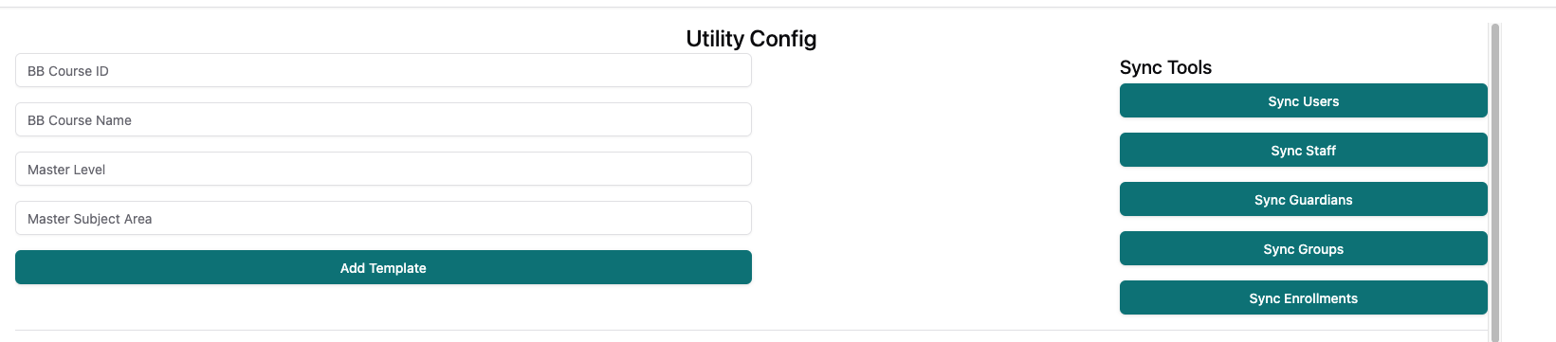
GUI Locations
Course Archive - GUI
Utility Page for Mass Update?
Notes:
- DONE

